Slide 1
Detecting DNA-protein Interactions
Xinghua Lu
Dept Biomedical Informatics
BIOST 2055

Slide 2
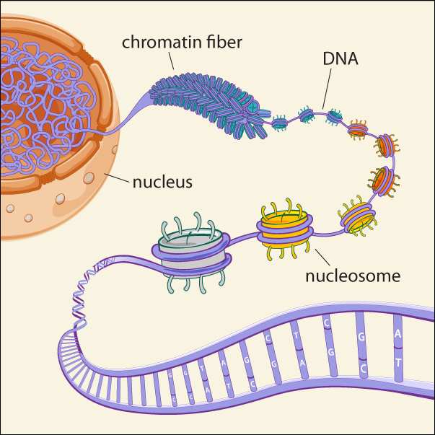
DNA and Proteins

Slide 3
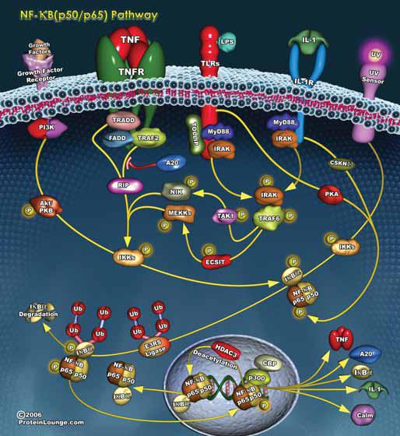
DNA-protein Interactions of Interest

Slide 4
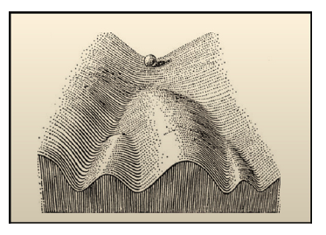
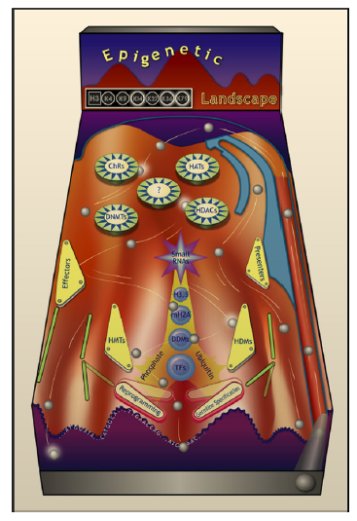

Slide 5
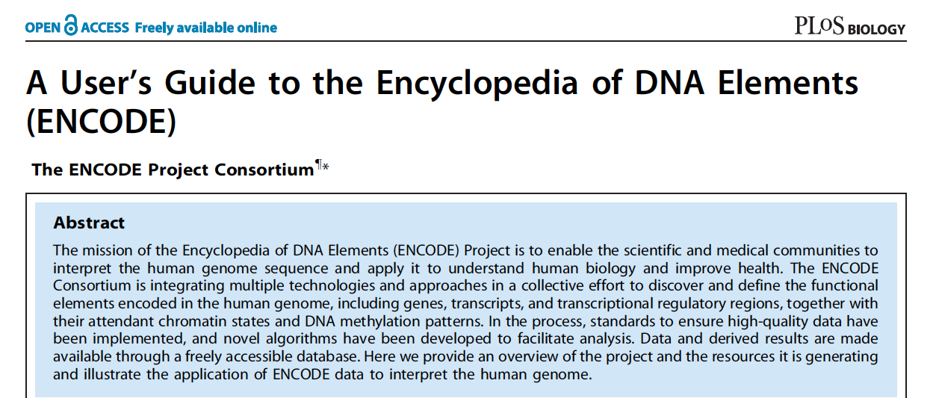
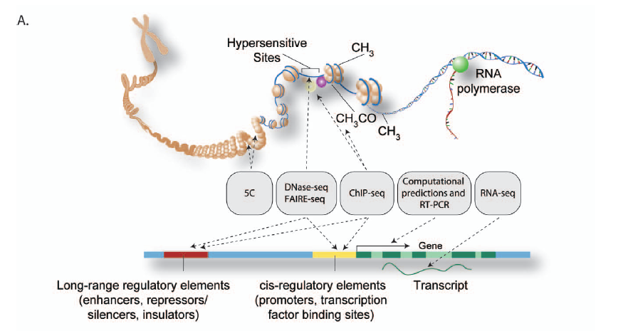
The ENCODE Project

Slide 6
ENCODE

Slide 7
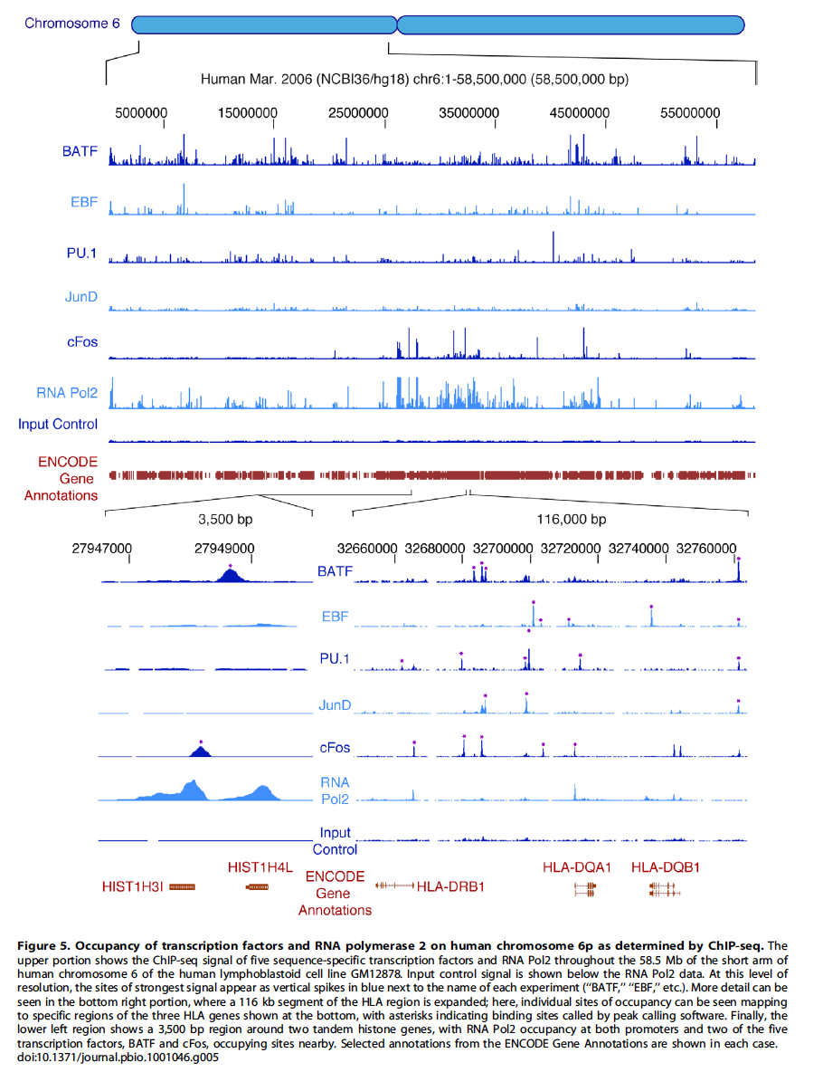

Slide 8
An Overview of Technologies
Study the interaction of specific DNA sequences and specific proteins
Gel shift assay
DNase footprint
Chip-Chip/Chip-seq
Study whole-genome-scale DNA-protein interactions or transcription sites
DNase-seq
FAIRE
Pol2-seq
Chromatin structure and high-level interactions
3C / 5C techniques

Slide 9
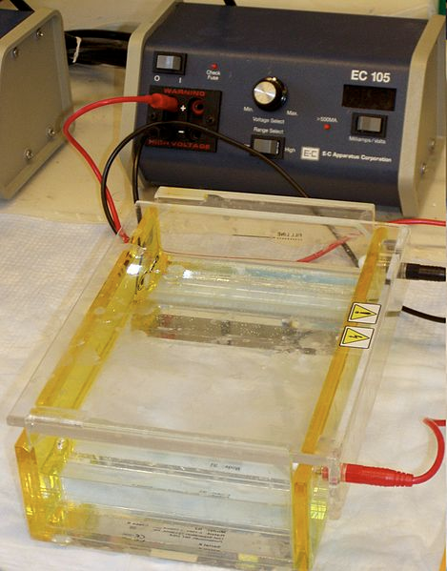
Early Techniques
Gel shift assay
Detecting DNA-protein interaction by electrophoresis
Incubate DNA and proteins of interest together
Require available of DNA sequence of interest
Load mixture onto electrophoresis gel
Mobility of DNA bound by proteins migrate slower in a gels

Slide 10
DNase Footprinting
Label DNA sequences of interest
Incubate with protein of interest with DAN
Subject samples to DNaseI
Expect random cut at restriction sites
Protein binding will protect DNA from DNaseI
Run on gel to detect
Test different concentration of the protein

Slide 11
Chip-Chip
Combining Chromatin-immunoprecipitation and DNA microarray (chip)
Enabling detection the genome-wide binding events of a protein of interest
Require antibody against the protein of interest

Slide 12
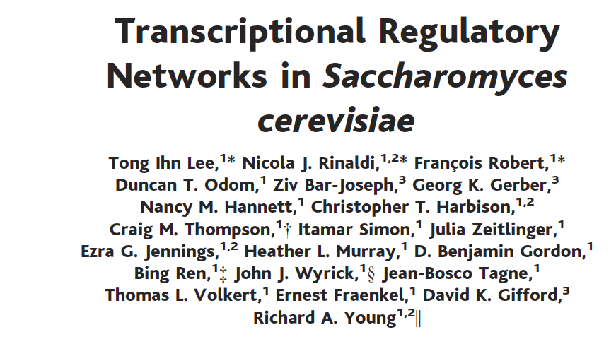
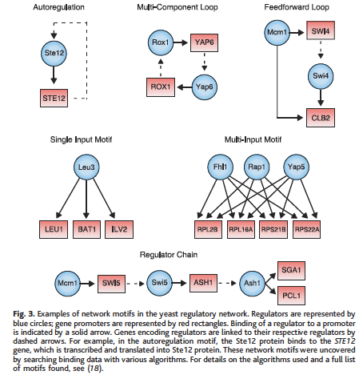
Networks found from TF-binding results
Chromatin immunopreciptation
Procedure

Slide 13
Chromatin enrichment:
Specific antibody IP
Label protein with tags and use generic Ab
Others
Chip:
cDNA microarray
Oligo-nucleotide microarrary, e.g., Affymetrix genome tile arrays

Slide 14
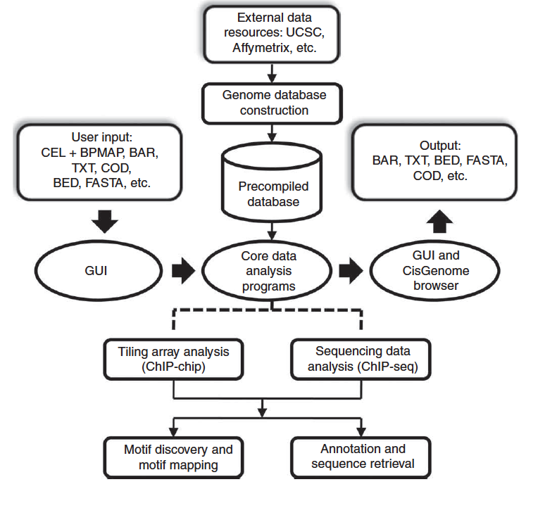
Chip-chip Analysis tools
Peak detections
Control condition
Statistical assessment
Results presentation
MAT by Liu’s lab,
http://liulab.dfci.harvard.edu/MAT/
CisGenome

Slide 15
Chip-seq
Chromatin immunoprecipitation coupled with high-throughput sequencing
A different way to read out the number of sequence bound by a protein
Potentially more accurate because not cross-hybridization

Slide 16
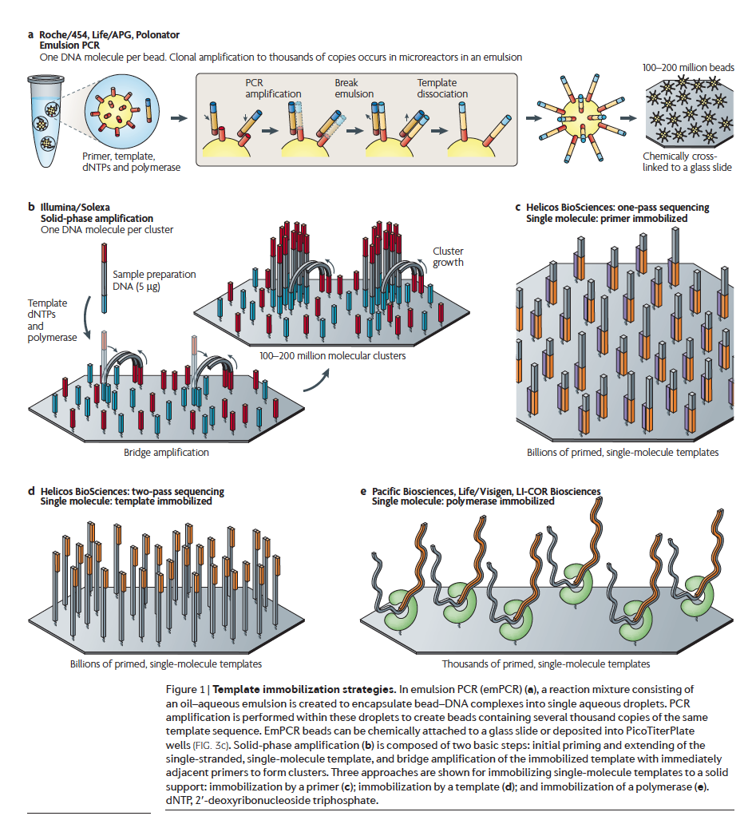

Slide 17
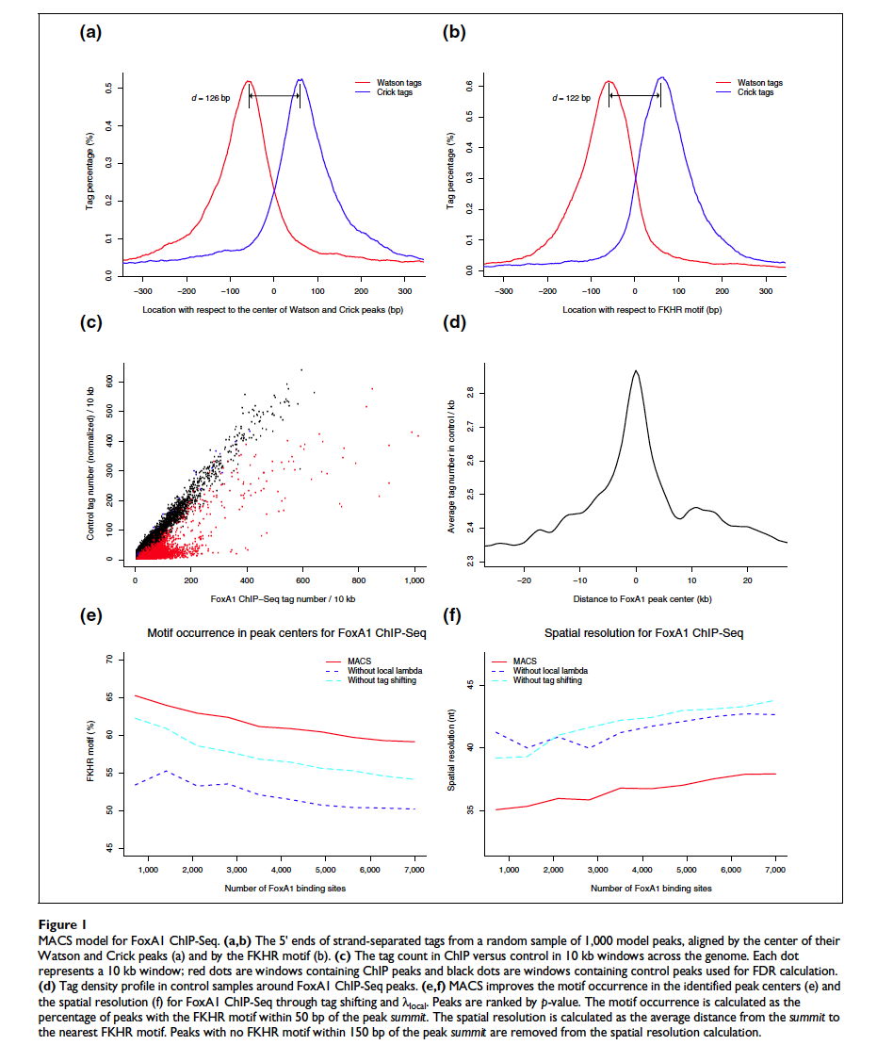

Slide 18
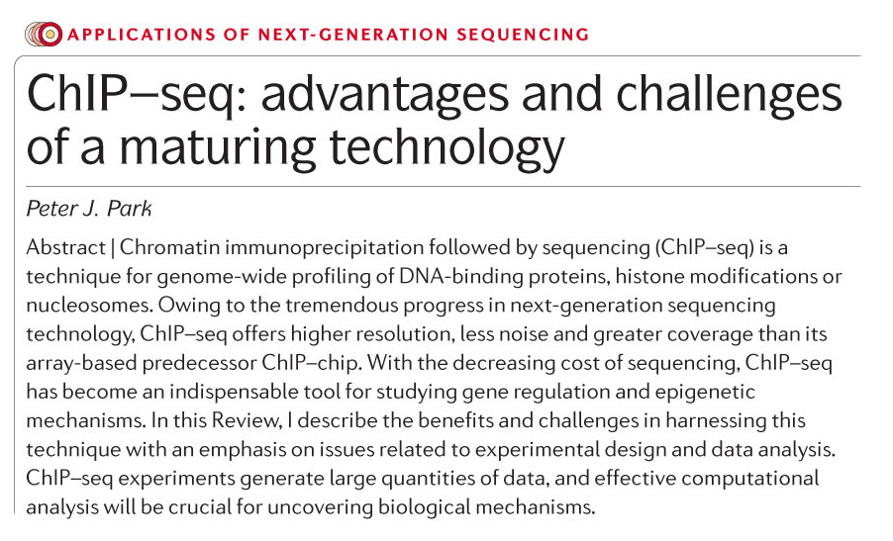
Nat Rev Genet(2009) 10:669

Slide 19
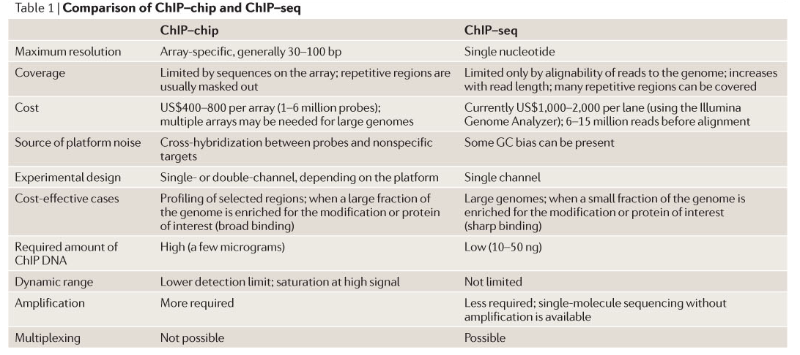

Slide 20
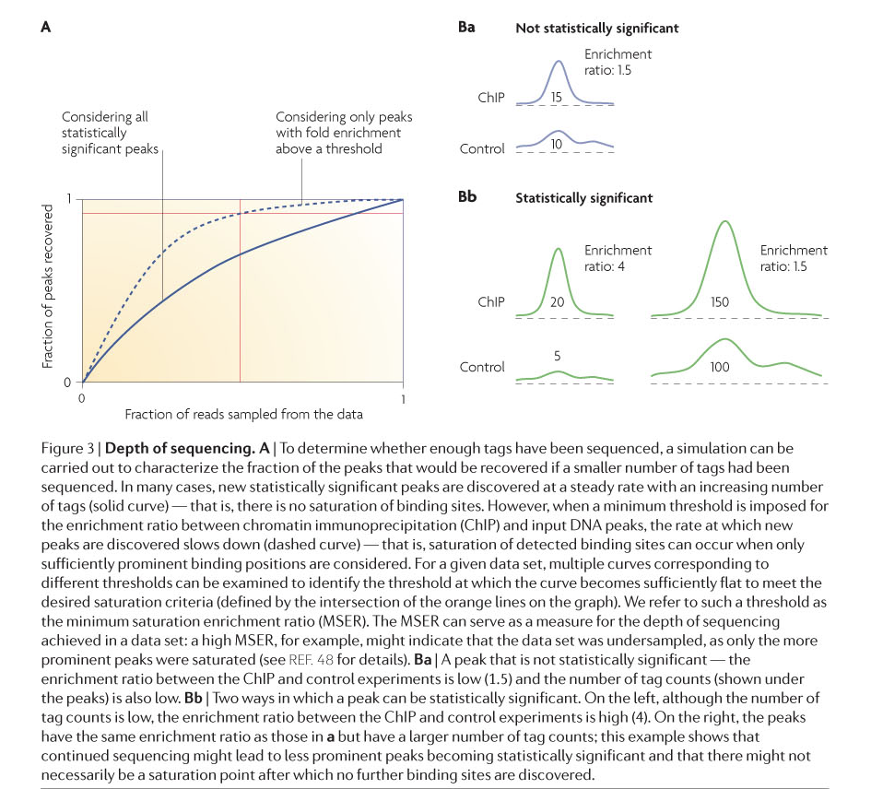

Slide 21
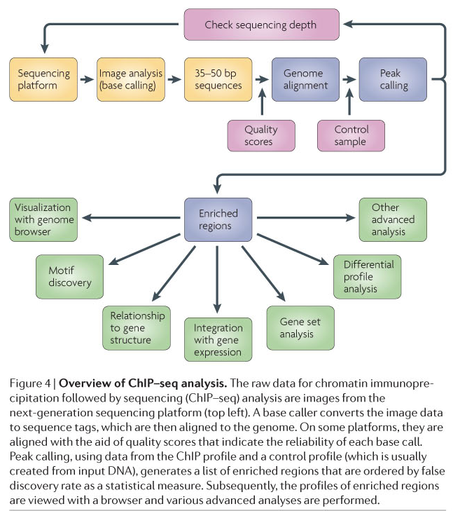

Slide 22
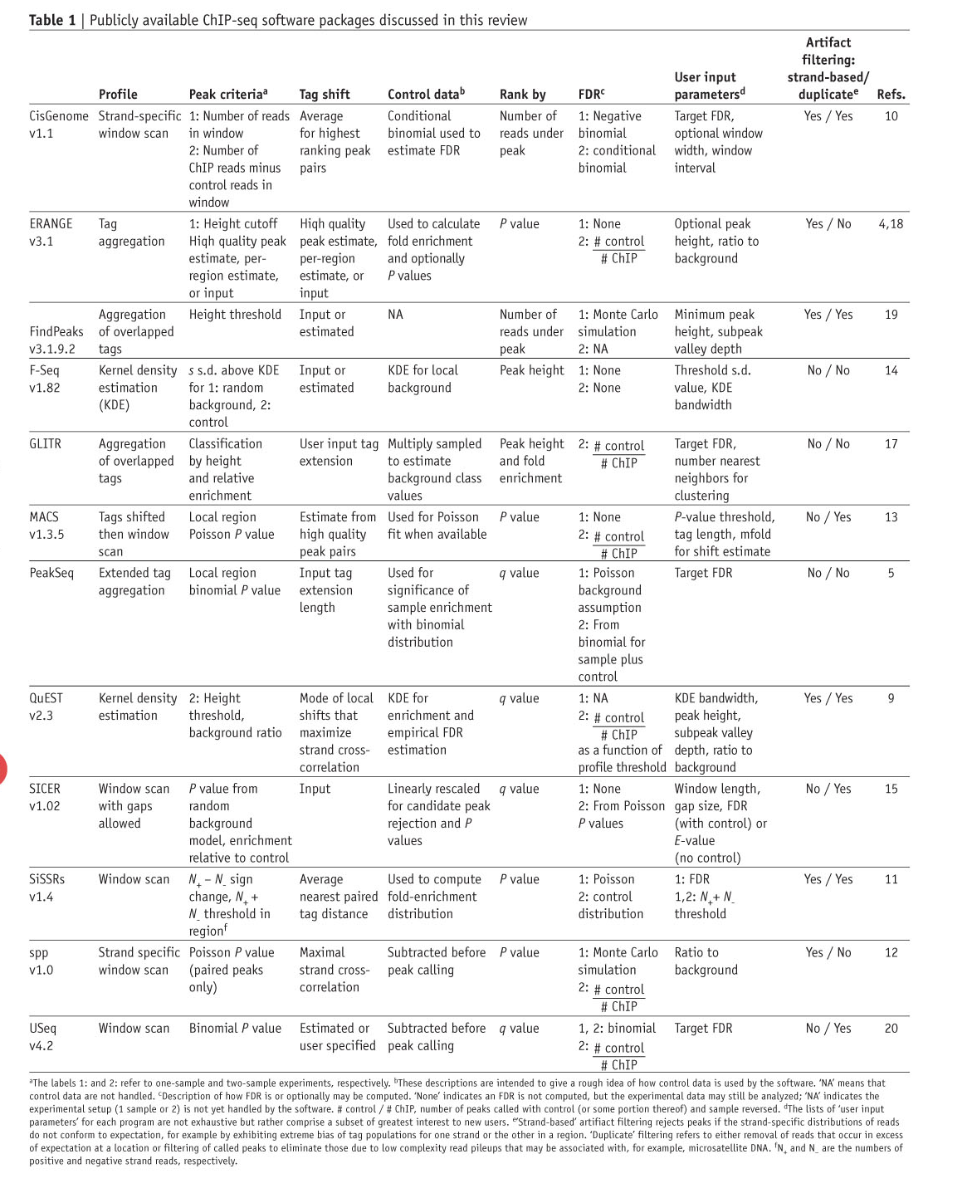
Pepke et al (2009) Nature Methods
6:S22

Slide 23
An Overview of Technologies
Study the interaction of specific DNA sequences and specific proteins
Gel shift assay
DNase footprint
Chip-Chip/Chip-seq
Study whole-genome-scale DNA-protein interactions or transcription sites
DNase-seq
FAIRE
Pol2-seq
Chromatin structure and high-level interactions
3C / 5C techniques

Slide 24
Dnase-seq
Chromosome loci that be actively transcribed are more sensitive to DNaseI digestion.
Molecular techniques are used to label and sequence the ends of the digestion sites
Map the sequence to the genome to reveal “hot” spots

Slide 25
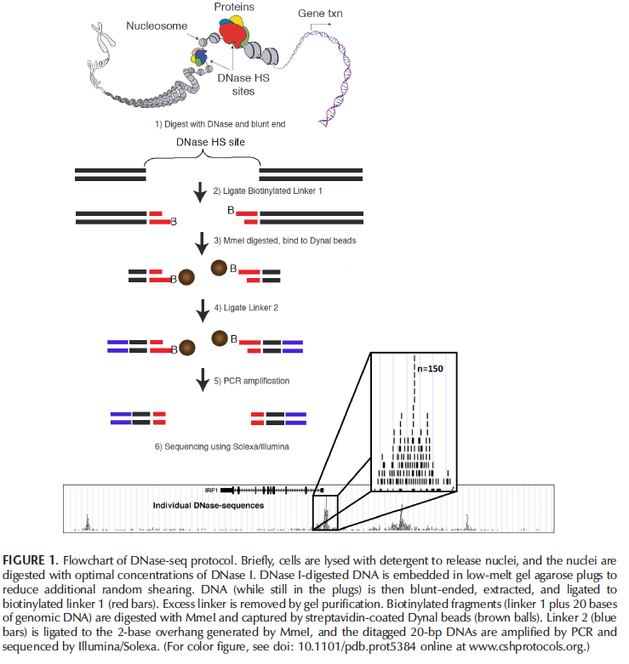

Slide 26
FAIRE
Formaldehyde-assisted Isolation of Regulatory Elements
Identify regions of genome that is “protein-free” as regions that active regions, indicating certain regulatory events are happening at the regions

Slide 28
Pol2-seq
Immunoprecipitation of RNA polymerase 2, the enzyme that transcribe genes into mRNA
Pol2 signals reflect formation of polymerase complex at chromosome
Signal reflect the number and kinetics of the transcription of gene

Slide 30
An Overview of Technologies
Study the interaction of specific DNA sequences and specific proteins
Gel shift assay
DNase footprint
Chip-Chip/Chip-seq
Study whole-genome-scale DNA-protein interactions or transcription sites
DNase-seq
FAIRE
Pol2-seq
Chromatin structure and high-level interactions
3C / 5C techniques

Slide 31
Chromatin High-level Structures
Chromosome Configuration Capture (3C); Circularized Chromosome Conformation Capture (4C); Chromosome Configuration Capture Carbon Copy (5C)
Detecting long distance interactions between fragments of chromosome, e.g., interaction of enhancers and transcription machinery
Using formaldehyde to cross-link interacting proteins and DNA fragments, followed by sequencing and mapping to genome

Slide 32
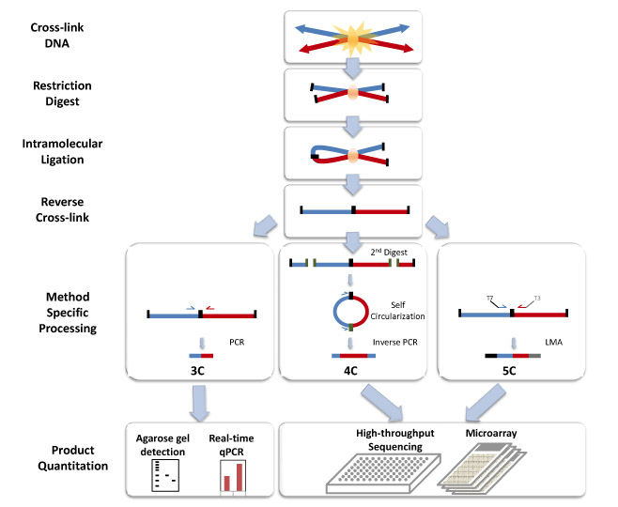

Slide 33
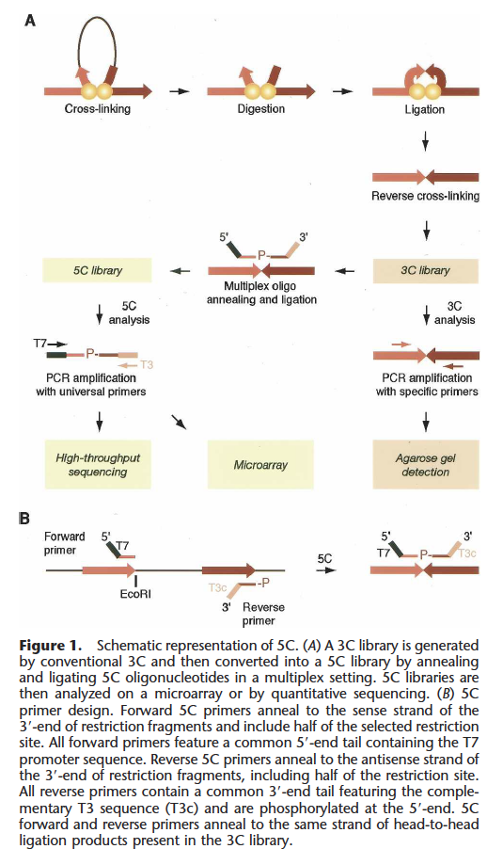

Slide 34
An Integrative View

